Slide 1

Analyze NYSE Data
A project by :Jawaher Batti Al-Saidi

Slide 2
We will discuss some points:
Total Revenue for Energy Sector in Year 1 & 4
Energy Research and Development
Calculations

Slide 3
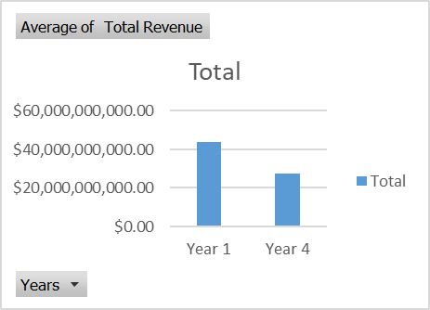
How Energy Research and Development Changed from the First to the Forth Year?
For the fourth year, we can see a significant loss in gross profit compared to previous years Total profit increased by $2,925,208,000.00. EOG's operating profit has not been stable over the years. Record operating profit of $2,951,071,000 in the first year. But it increased to $4,198,153,000 in the second year, which is $125 million more than the first year. The third year recorded an operating profit greater than the previous years, amounting to $6,218,276,000. But things changed in the fourth year, with an operating profit of $91,707,000, which is less than operating profit for the previous year.

Slide 4
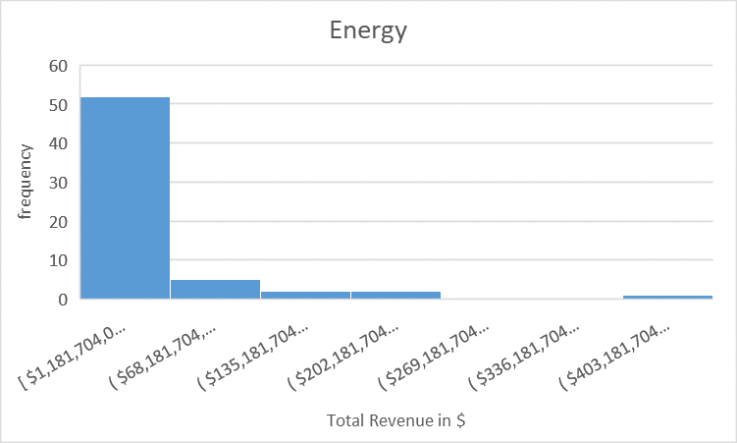
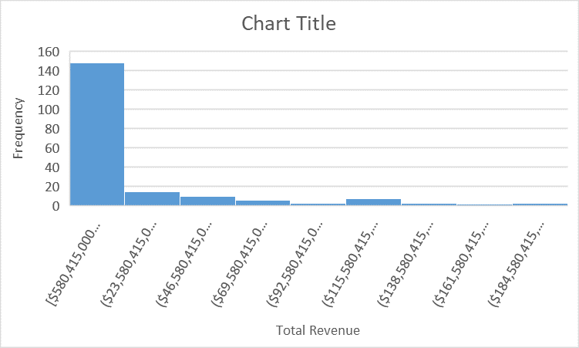
Total Revenue for Energy Sector in Year 1 & 4
On this histogram representation of Energy Sector and Financials Sector for years 1 and 4. From the histogram, we can say that both are right skewed which means the mean (Average) of the total revenue > median of the total revenue. The mean of Energy is about $35,42 while the mean of Financials is 20.8$. whereas the Energy median is $10,01 and in Financials is 10.3$. From the calculations, we can tell that the standard deviation of Energy is about $75,884,923,701.59, and S/D of Financials is about 26,4$ which is the Energy high S/D and this means that the total revenue from each company has a wider range. So, this means the values are spread out. The range is more higher for Energy $450,327,296,000.00 than Financials $75,884,923,701.59
Financials

Slide 5
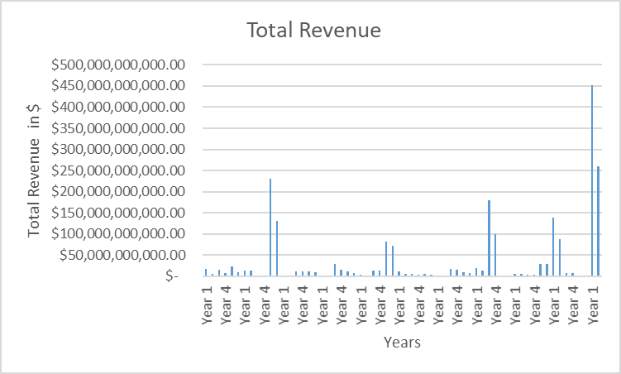
Total Revenue for Energy Sector in Year 1 & 4
The bar graph on the left is a subcategory of Energy Sector, Integrated Oil & Gas, showing in which year it earned the most revenue. We can see that Integrated Oil & Gas made the most revenue in Year 1 than in Year 4.In year 1, its total revenue was $ $1,352,502,544,000.00 and year 4 was $ $843,707,367,000.00

Slide 6
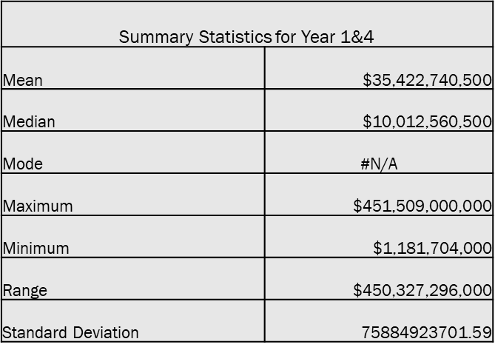
Calculations
MEAN= $35,422,740,500.00
MEDIAN= $10,012,560,500.00
MODE= NO VALUE.
MAX= $451,509,000,000.00
MIN= $1,181,704,000.00
RANGE= MAX - MIN = $451,509,000,000.00 - $1,181,704,000.00 = $450,327,296,000.00
S/D= =STDEV(C2:C63) = $75,884,923,701.59

